Slide 1
Attempts to emulate NUMA using QEMU

Slide 2
Approach
Emulator : QEMU
Configurations for VM
Approach to test remote/local access
Tools to measure
Conclusion after graph readings

Slide 3
QEMU
KVM
System into hypervisor
Configurable to various architectures

Slide 4
Week Overview
Latency and bandwidth configuration options for QEMU
For local and remote accesses
High latency and low bandwidth for remote accesses
Low latency and high bandwidth for local accesses
Previous tests based on function calls from the loaded shared object
Similar results for local and remote accesses as previous experiments
Expected results not achieved :(
No substantial difference in spite of modifying the emulator config

Slide 5
Implementation
Latency and bandwidth configuration for QEMU
-numa hmat-lb,initiator=0,target=0,hierarchy=memory,data-type=access-latency,latency=5
-numa hmat-lb,initiator=0,target=0,hierarchy=memory,data-type=access-bandwidth,bandwidth=200M
-numa hmat-lb,initiator=0,target=1,hierarchy=memory,data-type=access-latency,latency=200
-numa hmat-lb,initiator=0,target=1,hierarchy=memory,data-type=access-bandwidth,bandwidth=5M

Slide 6
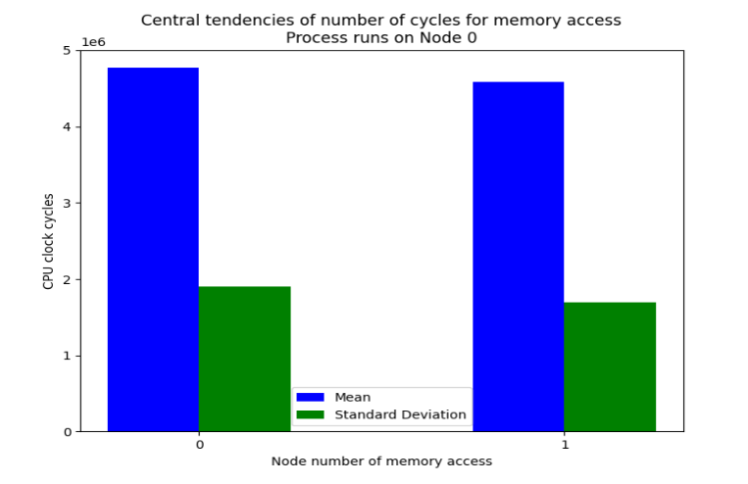
With latency and bandwidth configurations - Eg2

Slide 7
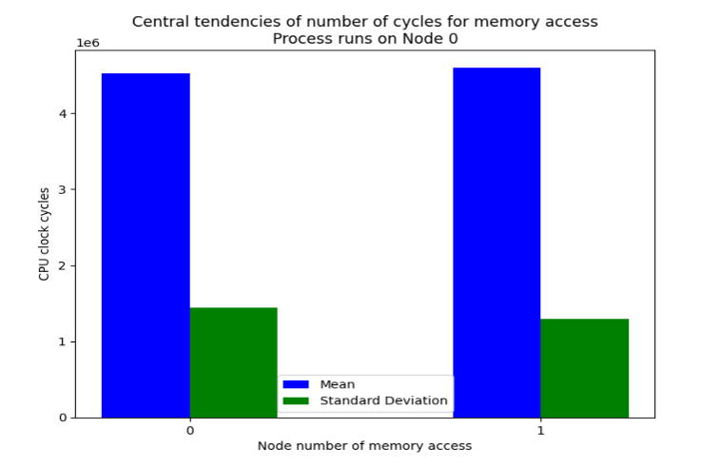
With latency and bandwidth configurations - Eg1
Notes:
Average over 100 excluding outliers

Slide 8
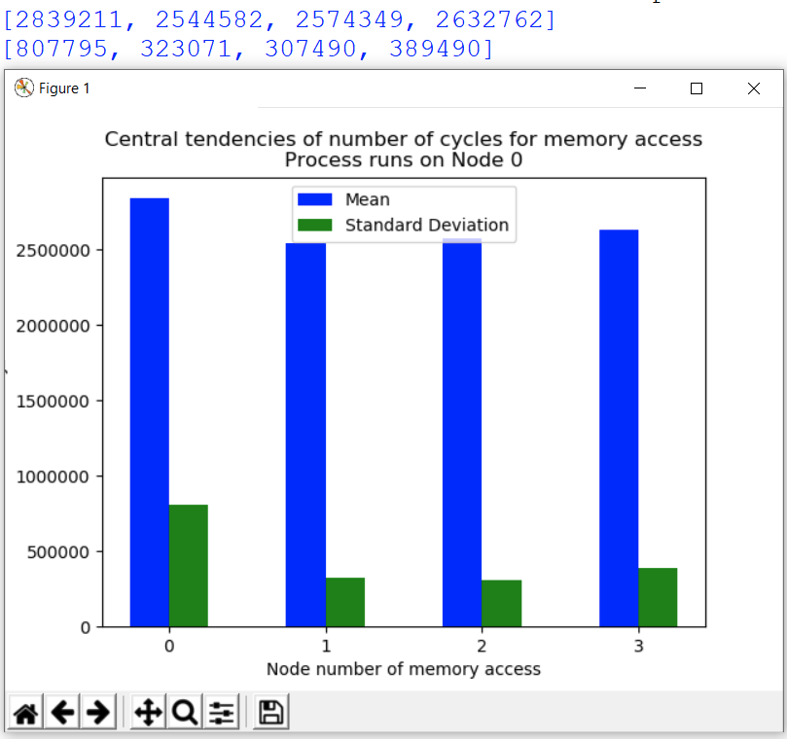
Original readings before latency and bandwidth configurations

Slide 9
Week Overview - Validation of our readings
Explored benchmark latency testing tools to validate our experiments
Tool - lmbench
Used to measure memory access latencies (excluding the instruction access times)
Used this in combination with numactl for cpu and memory binding
The latencies that we obtained for local and remote accesses, again did not bear any substantial difference
Shows that our experiments were valid, and that QEMU cannot be used for measuring performance characteristics
Went an extra step to also verify the memory allocation to specific nodes by lmbench
Tool - numastat
Ran this test during latency test and confirmed that data is being accessed from the specified nodes

Slide 10
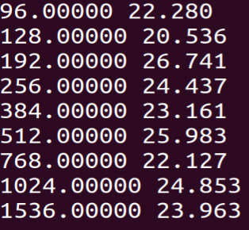
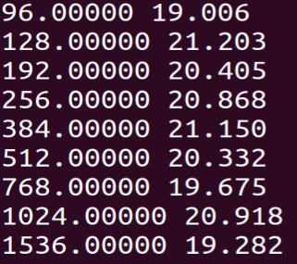
Implementation
Benchmark Latency Tool - lmbench
The lat_mem_rd function returns the latency times for varying sizes of memory accesses. The values on the left are memory sizes in MB, and the values on the right are latencies in ns.
numactl --physcpubind ${ComputeNodeNumber} --membind ${MemNodeNumber} ./lat_mem_rd ${dataSize} ${cacheLine}
Local
Remote

Slide 11
Implementation
We made sure not to consider the access times for smaller memories, since these accesses probably were cached.
This independent test must have showed the clear difference between local and remote accesses, but gave us the same results that our experiments had given.
Following are consecutive screenshots while the process is running, which shows increasing memory being allocated on the node specified

Slide 12
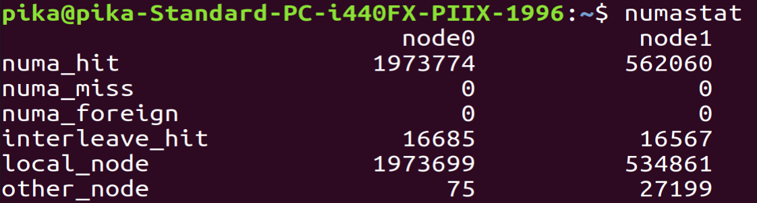
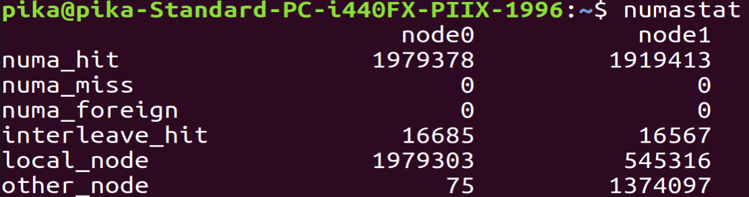
Memory Target : Node1

Slide 13
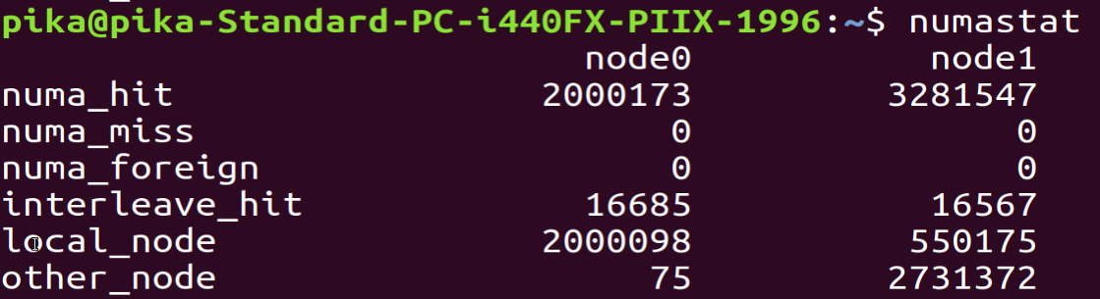
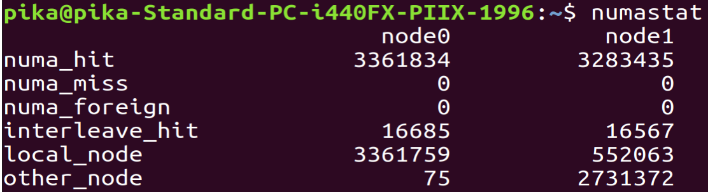
Memory Target : Node0

Slide 14
Week Overview
Read the official documentation and ensured that the configuration options specified by us are right
Re-verification of the set configurations
Intel Memory latency checker
Did not give results according to the set values (Matched the host values)
The results are on the next slide
Latency and bandwidth configuration for QEMU
Config values are inferior to host system
-numa hmat-lb,initiator=0,target=0,hierarchy=memory,data-type=access-latency,latency=40
-numa hmat-lb,initiator=0,target=0,hierarchy=memory,data-type=access-bandwidth,bandwidth=10G
-numa hmat-lb,initiator=0,target=1,hierarchy=memory,data-type=access-latency,latency=80
-numa hmat-lb,initiator=0,target=1,hierarchy=memory,data-type=access-bandwidth,bandwidth=5G

Slide 15
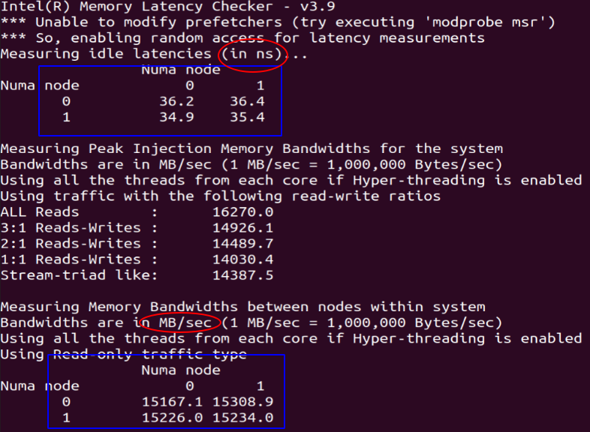
Confirmation test using Intel Memory Latency Checker

Slide 16
Week Overview
Filed a bug report for the feature
Bug report can be found here
Did not receive any response
Sent individual mails to many developers working on this feature
Lot of responses :)

Slide 17
Replies from QEMU developers
The host is a non NUMA machine so all guest RAM and CPUs are in the same latency domain, so that's why you are seeing pretty much the same timings.
Neither QEMU nor KVM, do not simulate HW latencies at all.
All that is configured with '-numa hmat-lb' is intended for guest OS consumption as a hint for smarter memory allocation and it's on to user to pin CPUs and RAM to concrete host NUMA nodes and use host's values in '-numa hmat-lb' to actually get performance benefits from it on 'NUMA' machine.
On non NUMA host it's rather pointless except of the cases where one needs to fake NUMA config (like testing some aspects of NUMA related code in guest OS).

Slide 18
Replies from QEMU developers
The configuration knobs are not there to limit bandwidth/latencies for virtual NUMA nodes, but to tell the guest the limits that the host NUMA nodes have.
The idea is, if you have an application that is sensitive to latency/bandwidth, you set the corresponding attributes in ACPI and let the guest kernel/application use it in scheduling decision.
Because without it, the guest is blind and doesn't really know the host’s limitations.

Slide 19
Further Actions
Run tests using the page replication patch on QEMU
Overcome technical difficulties of building the kernel (to prepare for efficient usage on AWS)
Moving to AWS for a NUMA machine only for final testing (we have $300 of free credits among us)
Finding the right services offered by Amazon
Learning how to use those services

Slide 20
Moving the project to AWS
The cheapest EC2 instance type with NUMA would be c5.8xlarge
$1.088 per Hour = 81.30 Rupees per hour
Storing our machine as an Amazon EBS volume is found to be extremely cheap
General Purpose SSD (gp2) Volumes | $0.10 per GB-month = 7.47 Rupees
Provisioned IOPS SSD (io1) Volumes | $0.125 per GB-month = 9.34 Rupees
Throughput Optimized HDD (st1) Volumes | $0.045 per GB-month = 3.36 Rupees
Cold HDD (sc1) Volumes | $0.025 per GB-month = 1.87 Rupees

Slide 21
Why we need Amazon EBS
Custom machine Image with the patch
C5.8xlarge supports only EBS storage
Non standard version of the kernel is not readily available as a machine image from Amazon
Although it is possible to build a kernel on ec2
Hence the optimal approach would be to use a bootable EBS Volume, giving us the flexibility to re-install patches whenever required

Slide 22
Installation of the replication patch
Tried installing the patch based on an old linux kernel (3.9v)
Overcame multiple roadblocks concerning version conflicts
There is however one final problem we are trying to rectify
After that, we can be confident of installing the patch and then try it on the EC2 instance

